Slide 1

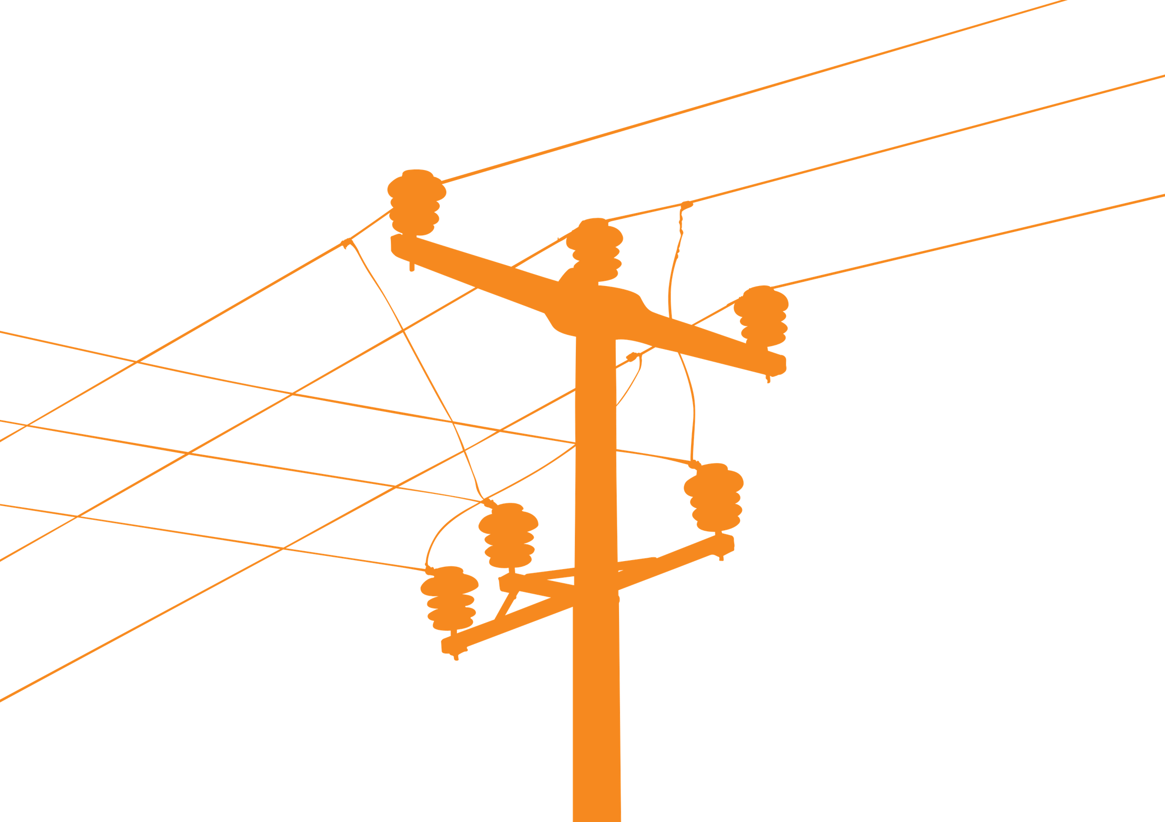

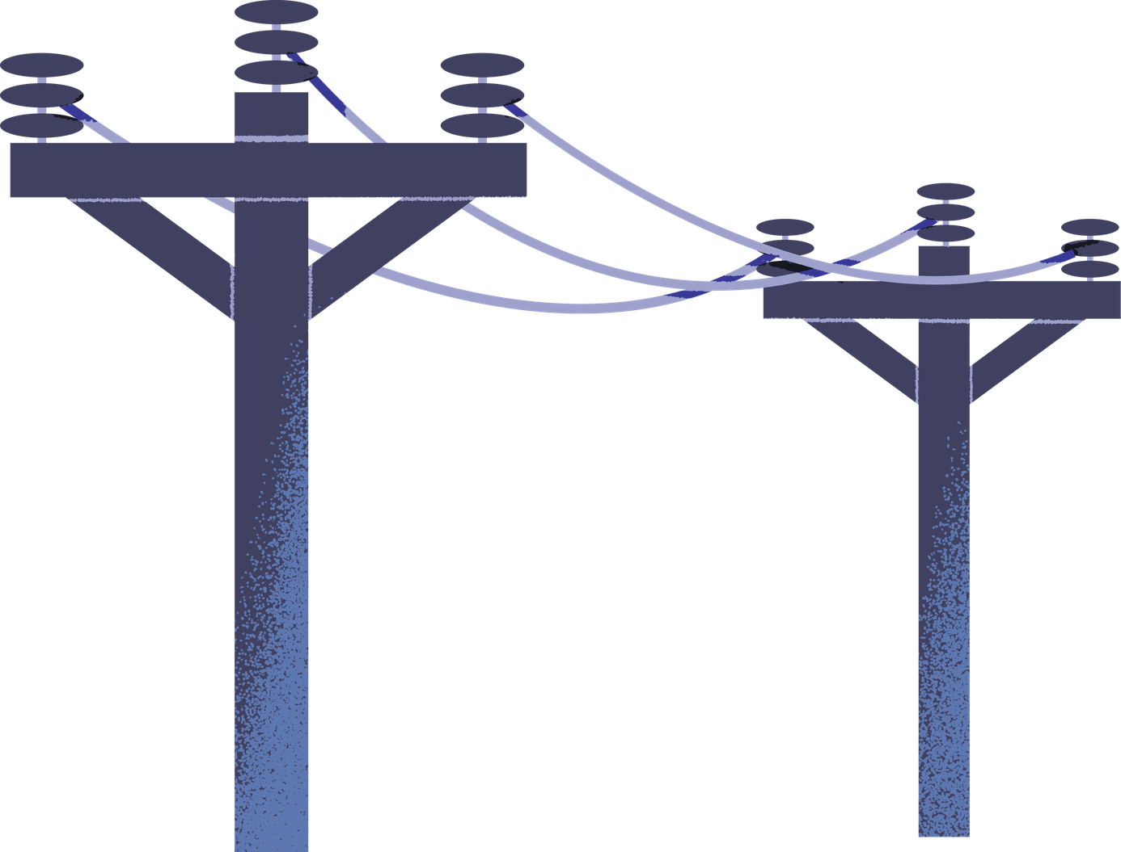
LEYECO III Grid Analytics: A Machine Learning-Driven GIS for Distribution Network Resilience
PRESENTED BY: Patrick Adrian Ocaña BSIT 4
SCHOOL: EVSU TANAUAN CAMPUS

Slide 2
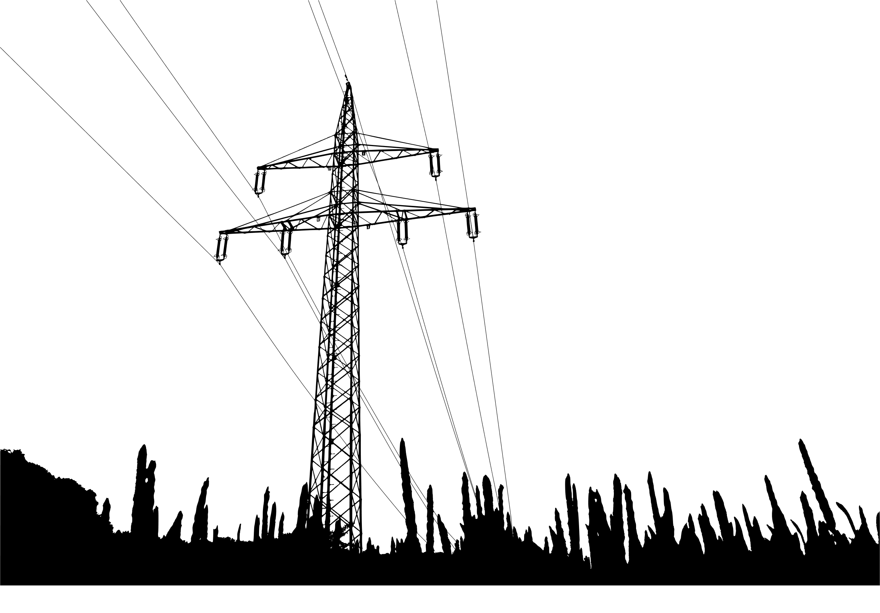
Project Objectives
1. GIS-Based Network Visualization
2. Faster Outage Restoration
3. Predictive Maintenance
4. Load Monitoring & Grid Optimization
5. Operational Efficiency

Slide 3
TECH STACK OVERVIEW
Backend: Python (Flask) with SQLAlchemy ORM for robust data management.
Database: PostgreSQL with PostGIS extension for spatial data processing and complex network queries.
Frontend: Responsive dashboard using Bootstrap 5, powered by Leaflet.js for real-time GIS visualization of poles and lines
Analytics Engine: Powered by Pandas and Scikit-learn for unsupervised anomaly detection and load stress modeling.

Slide 4
KEY FEATURES
Interactive Geospatial Visualization (GIS)
High-Performance Network Tracing
AI-Powered Risk Analytics
Dynamic Outage Simulation
Intelligent Data Ingestion
Enterprise Security & RBAC

Slide 5

Interactive Geospatial Visualization (GIS)
Layered Mapping: Real-time rendering of poles, primary lines, secondary loops, and consumer service drops on a dynamic map (Leaflet.js).
Asset Drill-down: Clickable map markers that reveal technical specifications and linked consumer data for every asset.

Slide 6
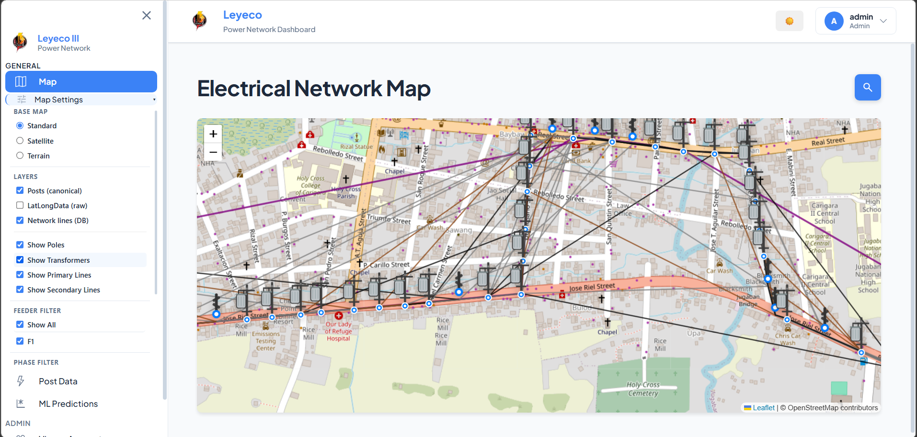
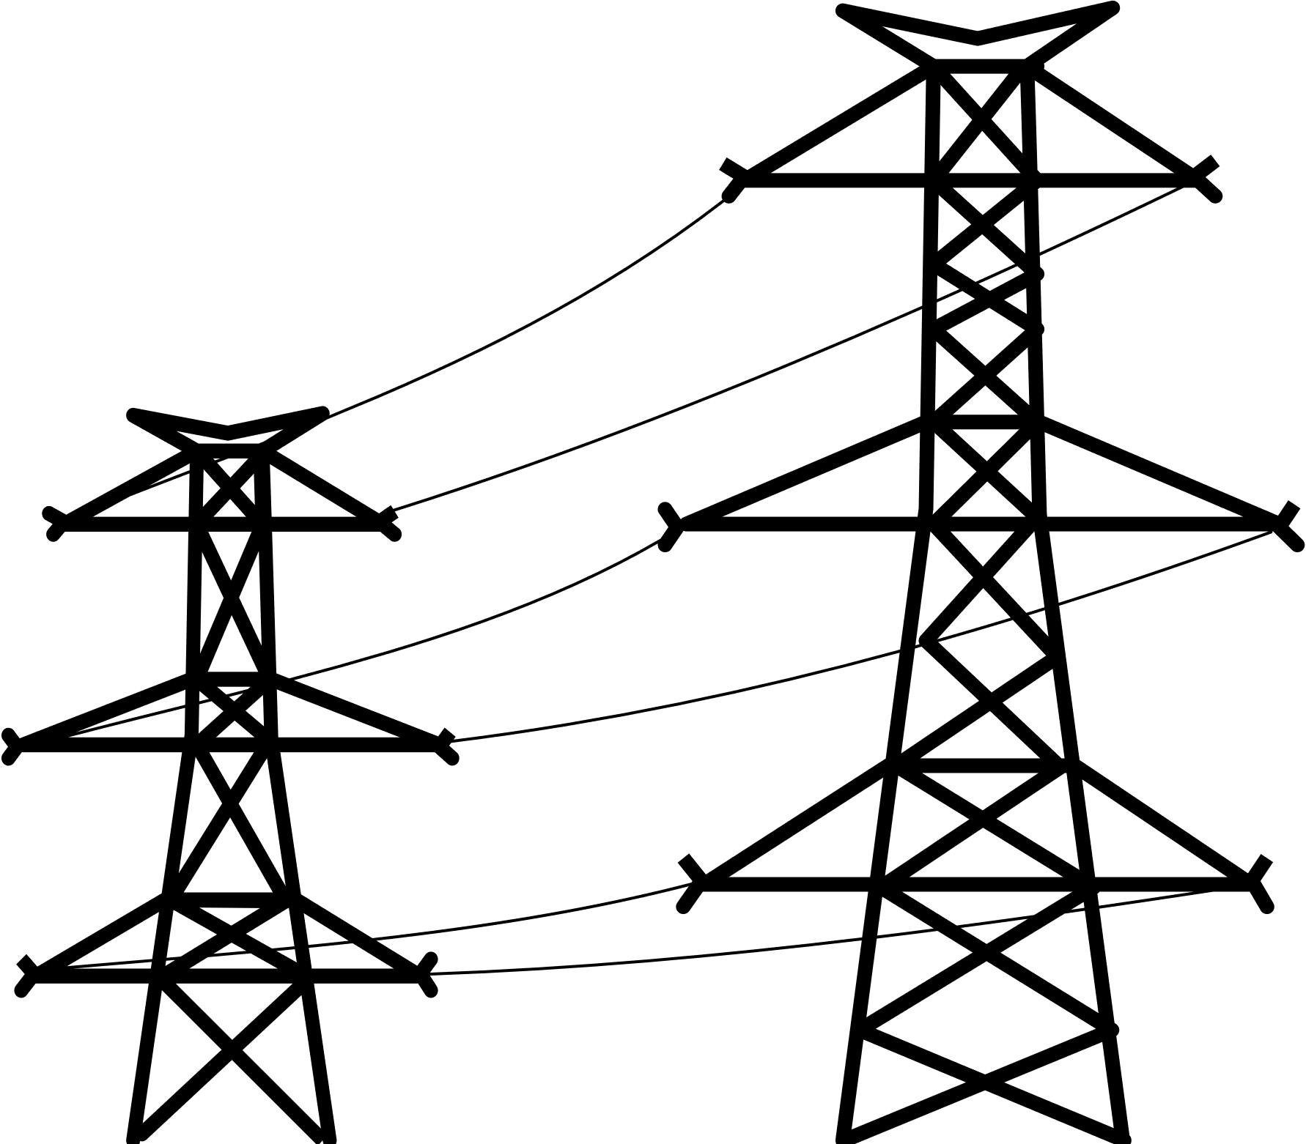

Slide 7
High-Performance Network Tracing
Upstream & Downstream Analysis: Uses SQL Recursive CTEs for lightning-fast tracing from the substation down to the consumer level.
Secondary Discovery (BFS): An intelligent Breadth-First Search algorithm that "crawls" the secondary network to find every household connected to a specific transformer group.

Slide 8
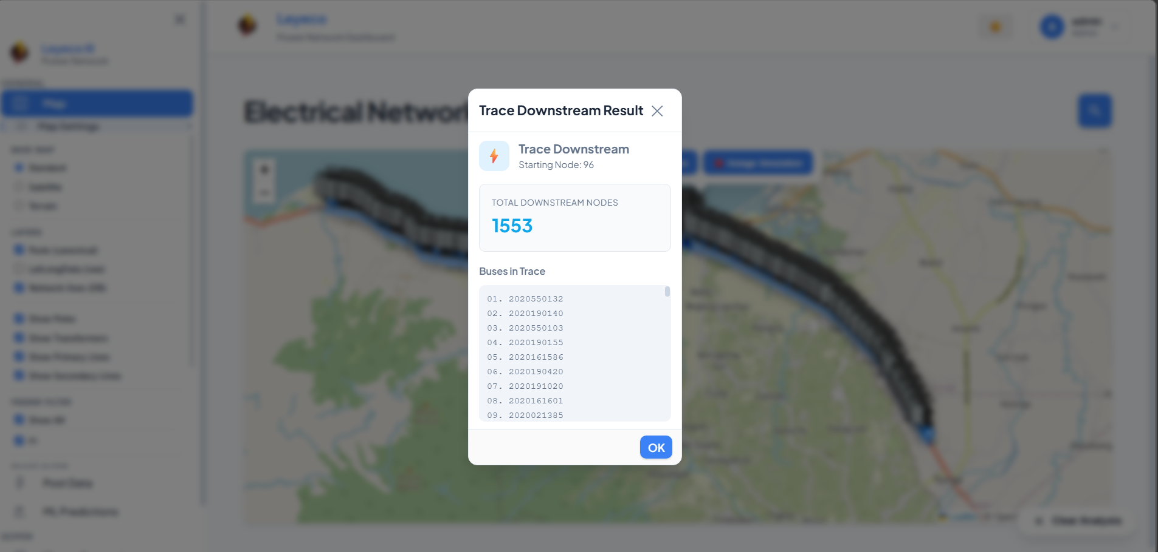

Slide 9
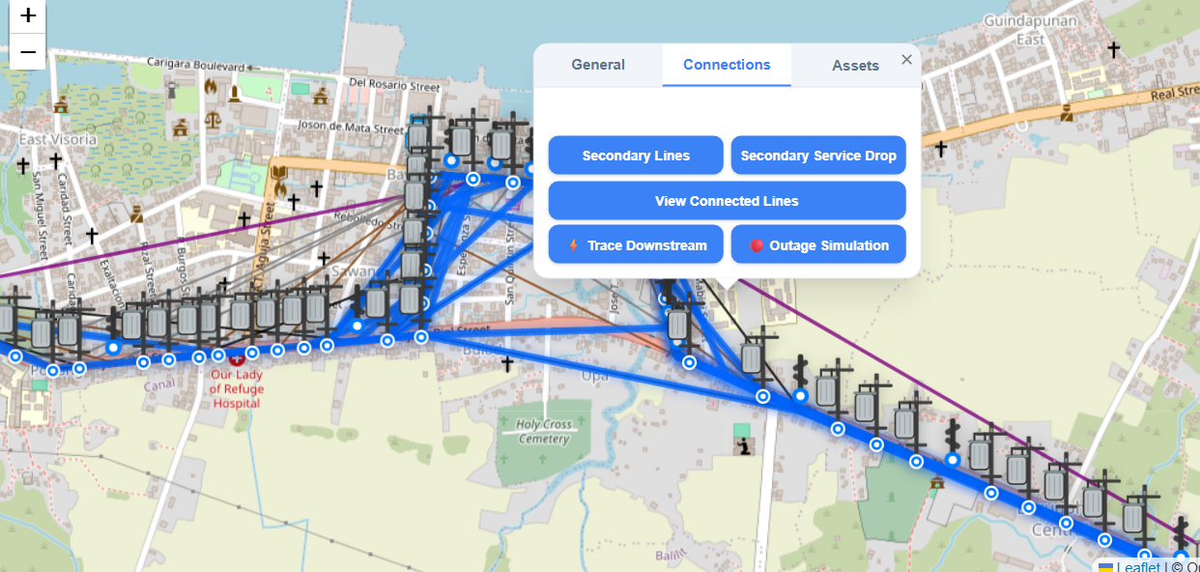
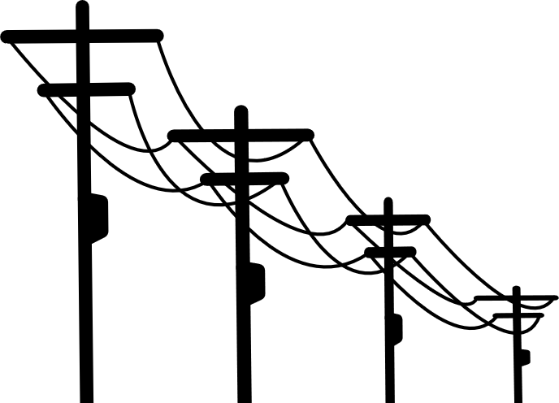

Slide 10
Dynamic Outage Simulation
What-If" Modeling: Allows engineers to simulate a pole failure and instantly see the number of affected customers and the total estimated Load Loss (kWh).
Impact Priority Ranking: Automatically ranks failures by severity, highlighting outages that affect the most people or the highest electrical load.

Slide 11
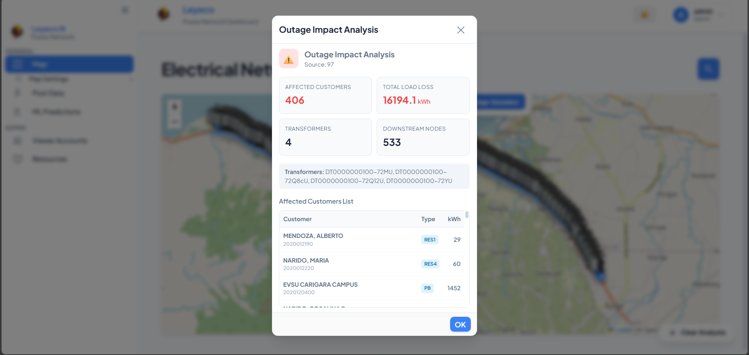

Slide 12

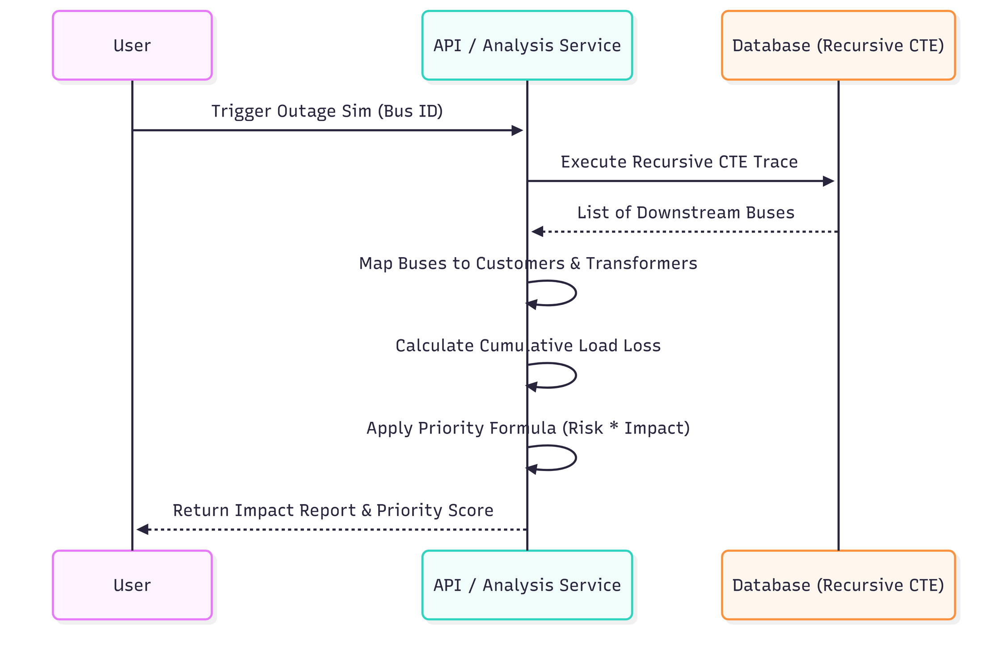

Slide 13
Intelligent Data Ingestion
Flexible CSV/XLS Importer
Automated Topology Builder

Slide 14
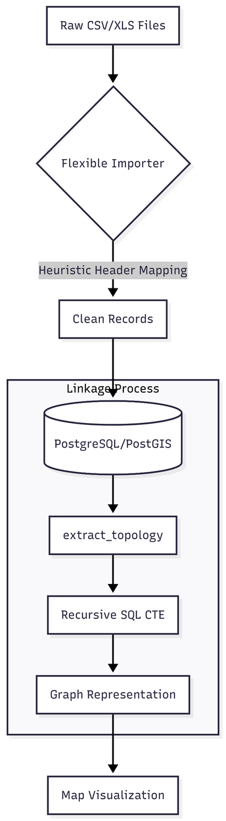


Slide 15
Enterprise Security & RBAC
Role-Based Access Control: Strict separation between Admins (full system control) and Viewers (read-only field access).
Secure Viewer Access: Uses admin-generated highly secure Access Codes to allow field crews access without needing a full password account.

Slide 16
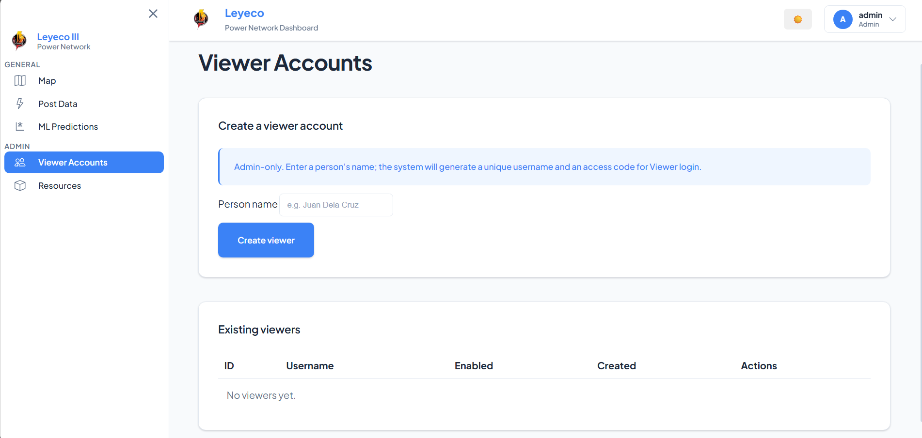


Slide 17
AI-Powered Risk Analytics
Predictive Maintenance Model: Uses Isolation Forest (Machine Learning) to detect anomalies in transformer performance before they result in a blackout.

Slide 18
Machine Learning (Unsupervised)
Predictive Analytics: Anomaly Detection
Algorithm:
- Isolation Forest (Unsupervised)
Purpose:
- Detect abnormal transformer behavior
- No need for historical failure labels
Outcome:
- Identifies high-risk infrastructure early

Slide 19
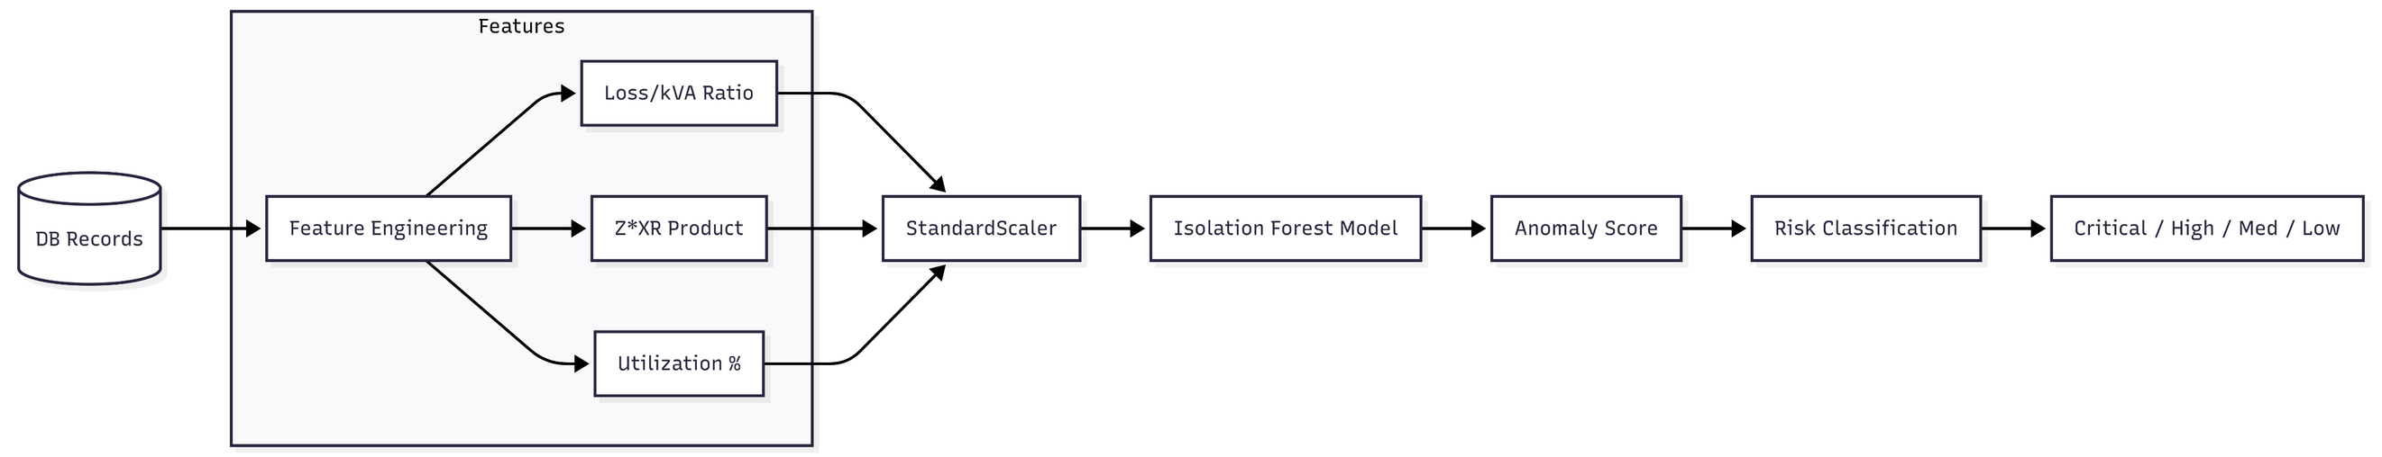
FLOW CHART

Slide 20
Features use in ML
- Efficiency Ratios
(Loss-to-kVA)
- Impedance Characteristics
(%Z and X/R interaction)
- Operational Stress or Load Stress
(Load utilization %)

Slide 21

Risk Score Formula

Slide 22
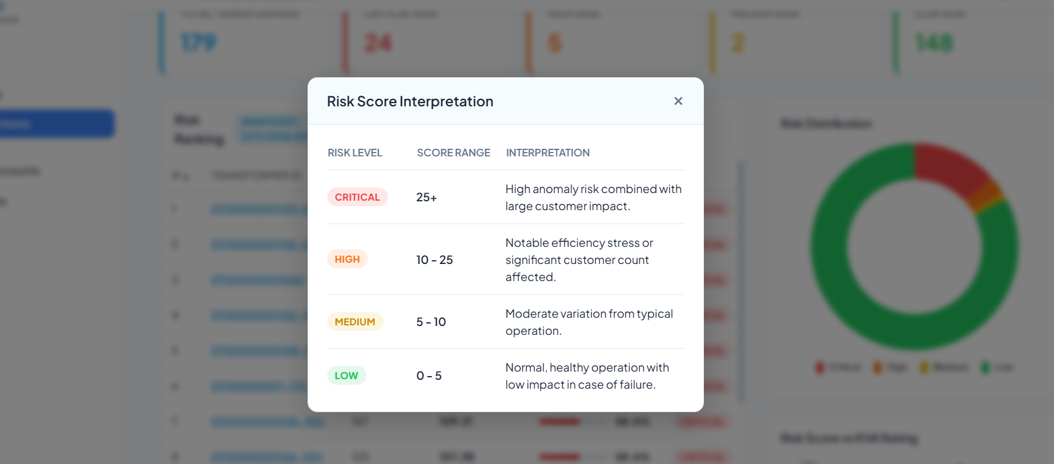

Slide 23

Load Stress Calculation

Slide 24
Impact score formula

Slide 25
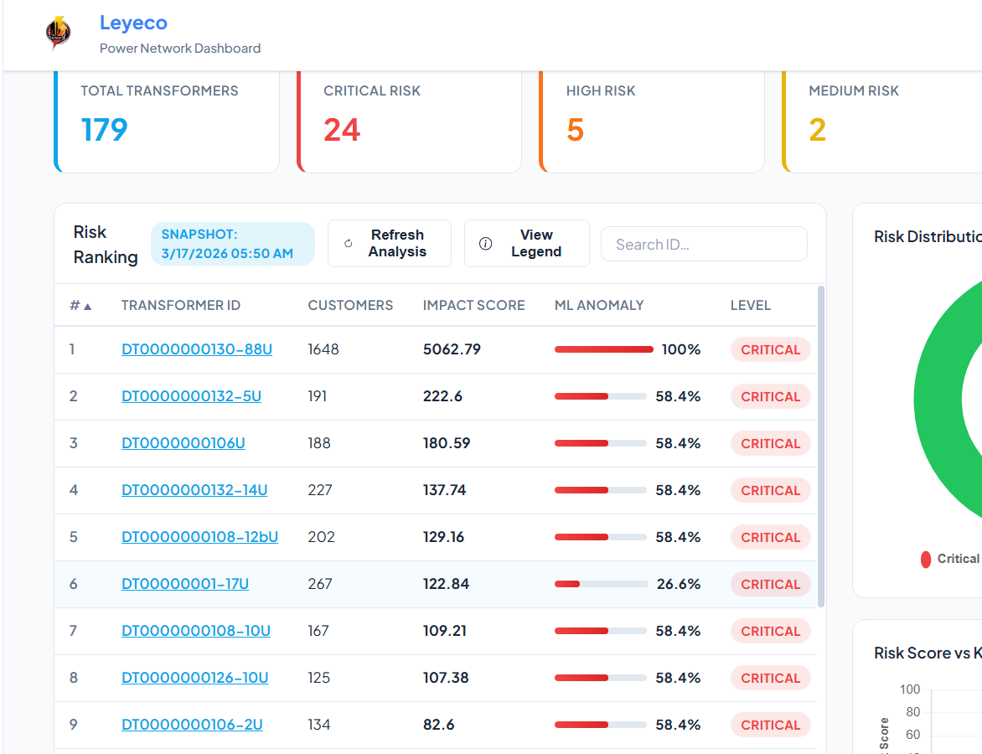

Slide 26
System Value Proposition
From Reactive → Proactive System
- Detect failures before they occur
- Prioritize high-impact transformers
- Reduce downtime
- Improve service reliability

Slide 27

Scalability and Performance
- Database-level computation (PostGIS + CTE)
- Handles large-scale grid data
- Efficient spatial indexing
- Minimal backend load

Slide 28

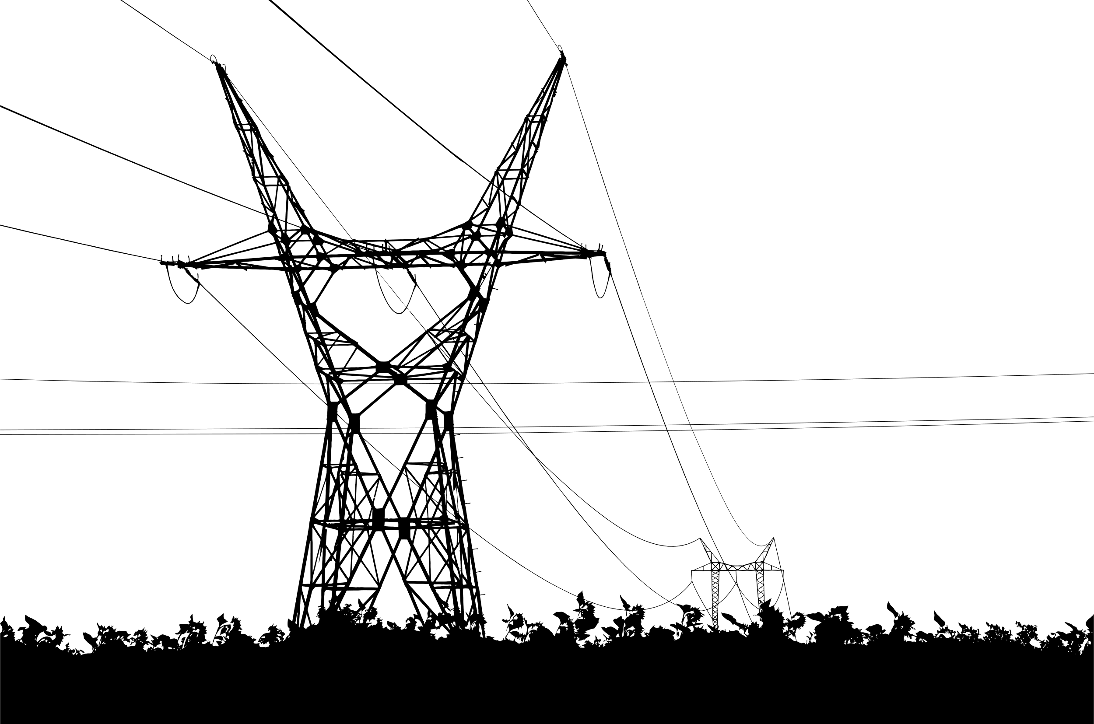
Key Takeaway
Proactive Maintenance System
Fast outage impact analysis for large networks
Reduces operational cost
Improves customer satisfaction

Slide 29
POSIBLE UPGRADE IN THE FUTURE
ADVANCE AI-MODEL
Instead of anomaly detection, the system can be upgraded to a more advanced AI model called failure prediction if sufficient historical data is available, such as past transformer failures, load patterns, maintenance records, and environmental conditions.
Automated Load Balancing Recommendations(AI-MODEL)
The system can recommend load redistribution strategies to prevent transformer overloading by analyzing real-time or historical load data, network connectivity, and transformer capacity, then suggesting optimal reconfiguration of load across nearby transformers.
Integration with Billing System
Integration with billing systems can improve accuracy of load analysis and customer impact assessment

Slide 30
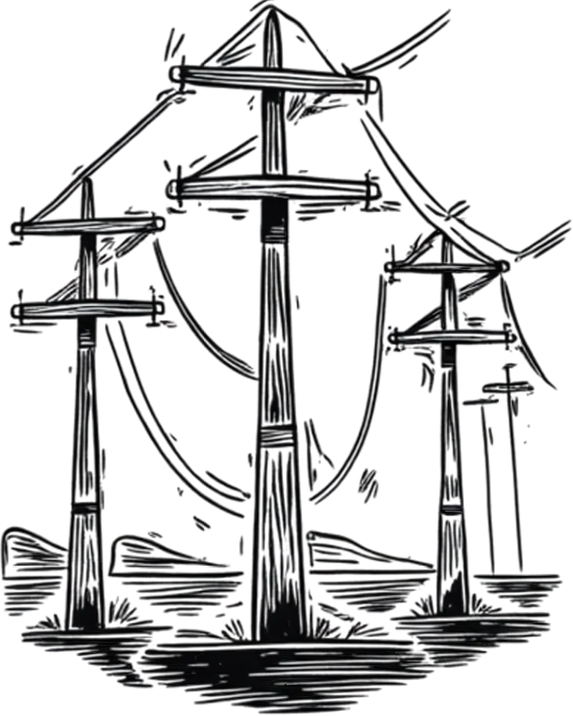
THANK YOU!
Open forum

